Slide 1
CGAN Project
Project Presentation
Presented by: Mabin Varghese

Slide 2
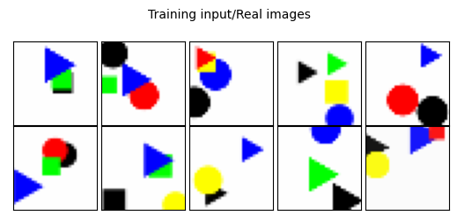
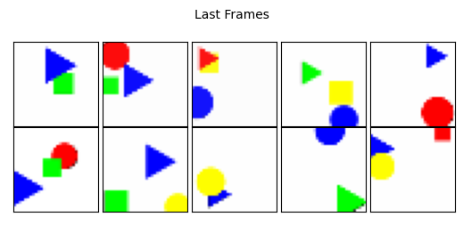
Task And Objective
Dataset: Flying objects -> set of frames
Extract FF and LF of every sets (Total 300 sets)
Build a Generative adversarial network

Slide 3
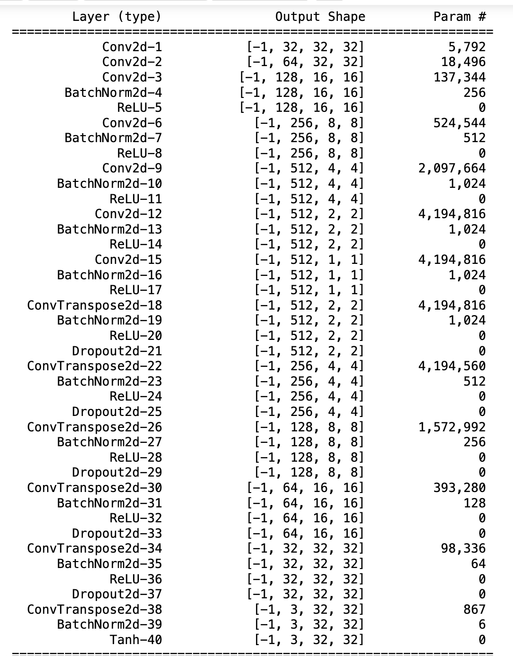
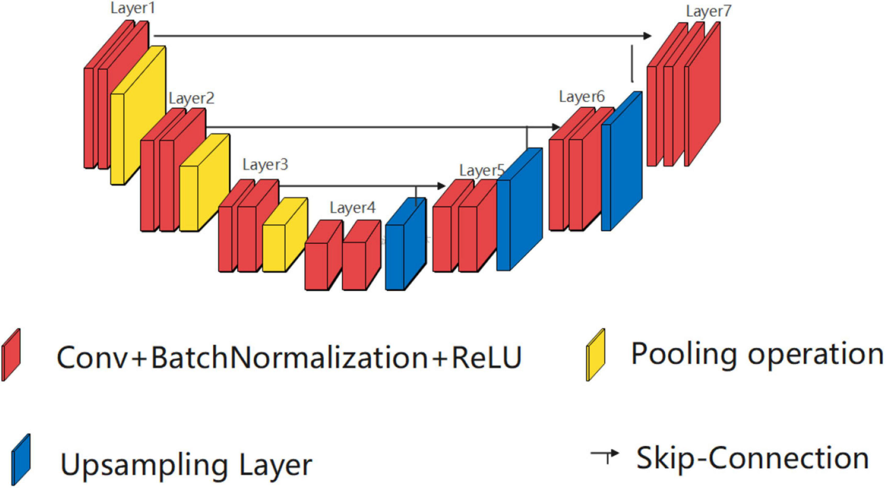
Model Architecture
Generator Model
UNET generator model -> Typical for Image segmentation
Encoder and decoder
Skip connections -> preserve spatial features and capture low- and high-level feature
Noise – Random noise with a normal distribution
https://www.frontiersin.org/files/Articles/841297/fnagi-14-841297-HTML-r2/image_m/fnagi-14-841297-g001.jpg

Slide 4
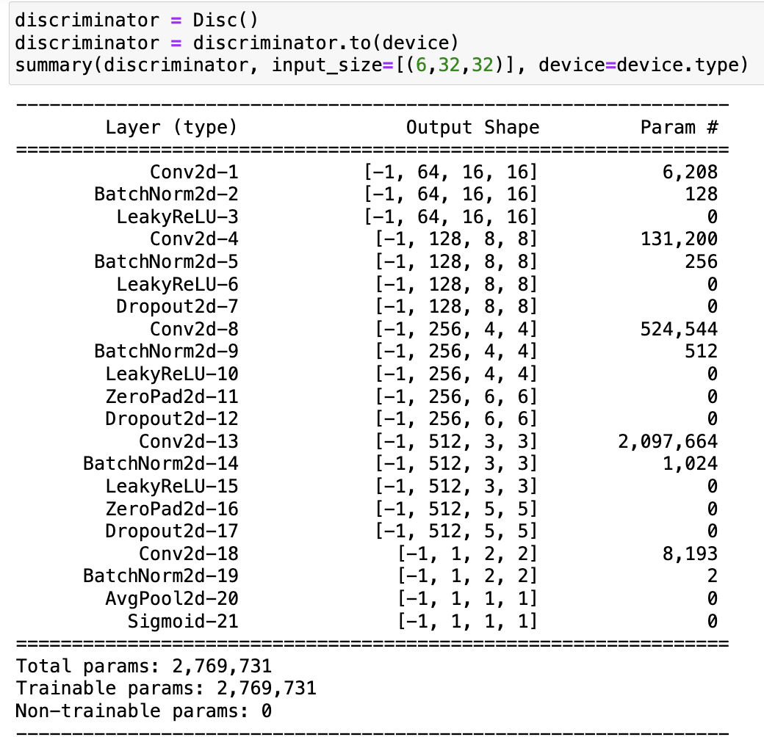
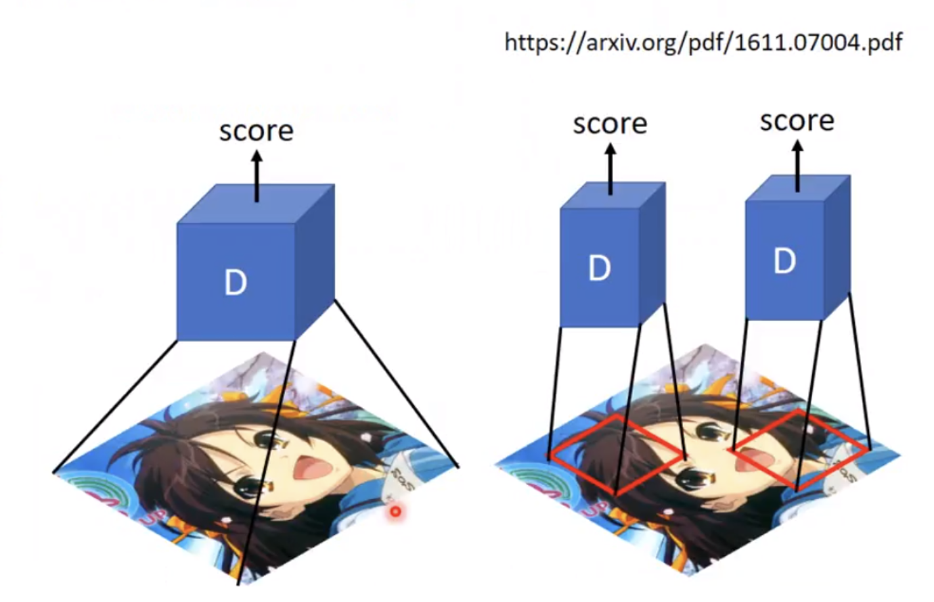
Discriminator Model
Patch GAN discriminator model -> maps a NxN array to the patch from the real images.
Series of convolutional layers, batch normalization, leaky ReLU activations, dropout layers, and a final classification layer with a sigmoid activation function.
Input the condition in discriminator also

Slide 5
Dataset & Transformation
Original Dataset
Training – 300 pairs
Validation – 60 pairs
Testing - 60 pairs
Augmentation -> to increase pairs
Color jitter
Gaussian blur
New Dataset
Training – 882
Validation– 252
Testing - 126

Slide 6
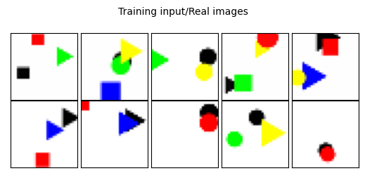
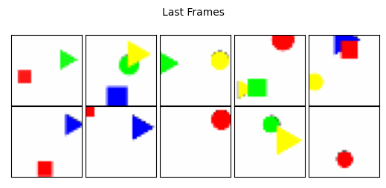
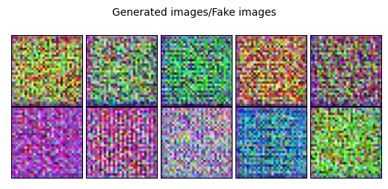
First Epoch Before Training

Slide 7
Conditional GAN Training
Initialized Xavier weights
Applied learning rate scheduling based on validation losses
Simultaneous Gen() and Disc() Training
Evaluation while training
Losses
L1 Loss – Assessing similarity b/w generated image and real image
SSIM scores
Visual inspection

Slide 8
Visualization on the 1st Epoch
SSIM Score : -0.083

Slide 9

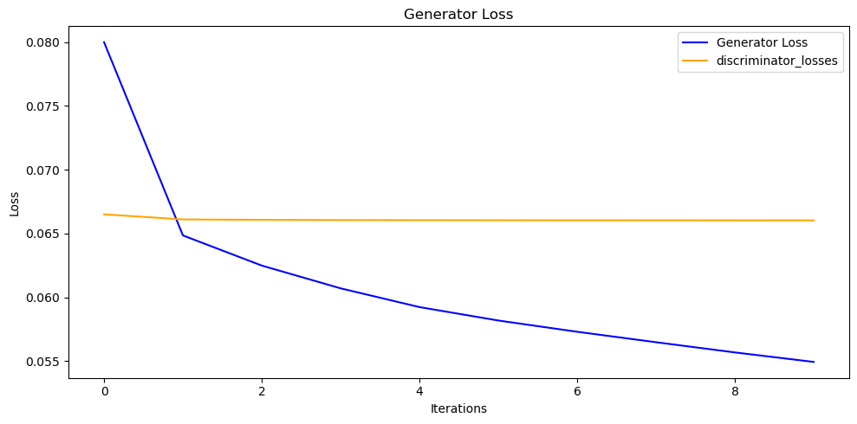

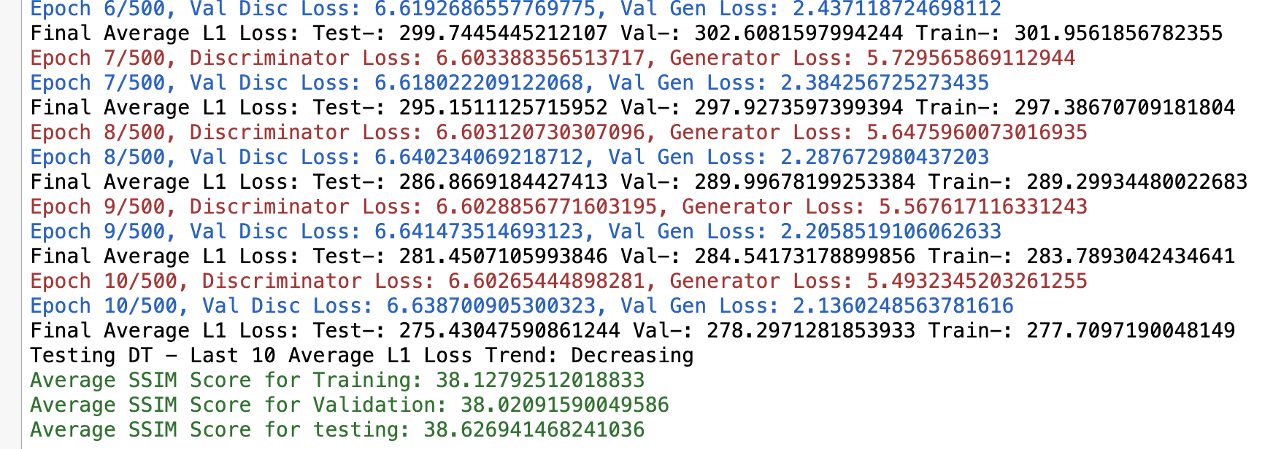
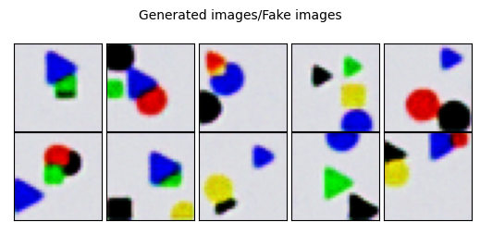
After 10 Epoch

Slide 10
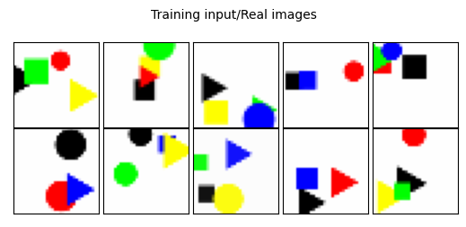
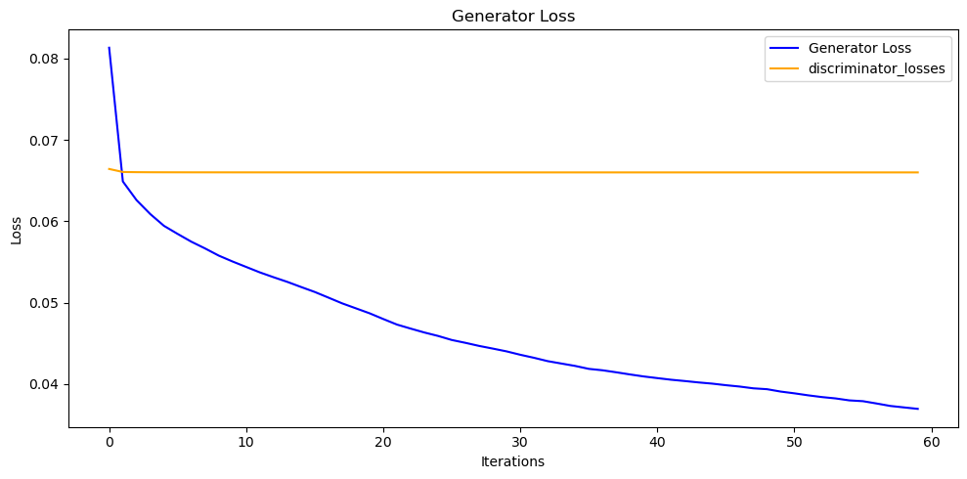
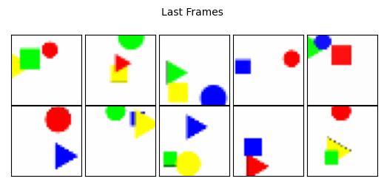
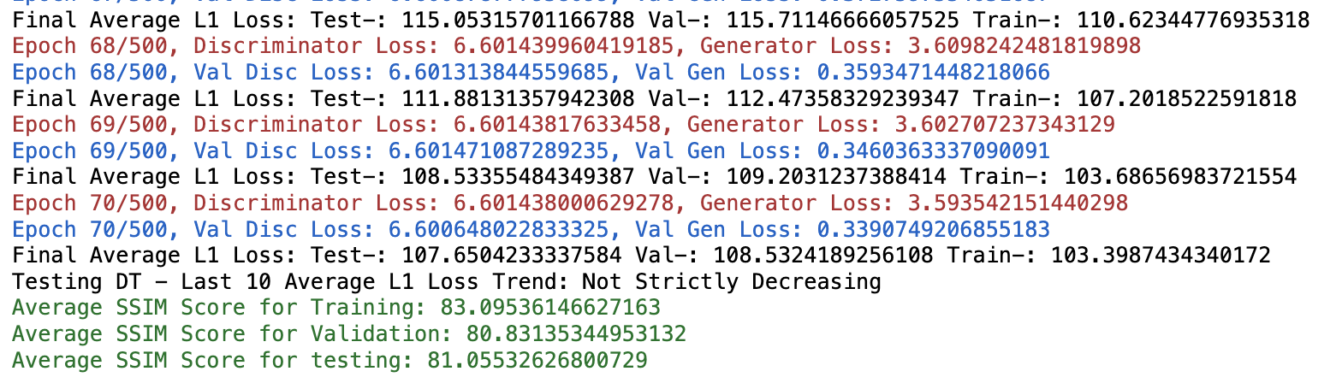
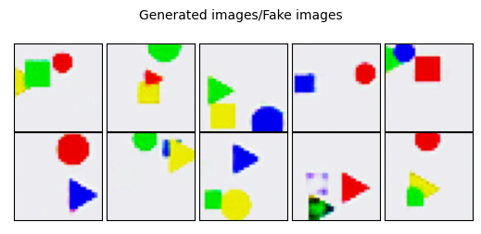
After 70 Epoch

Slide 11
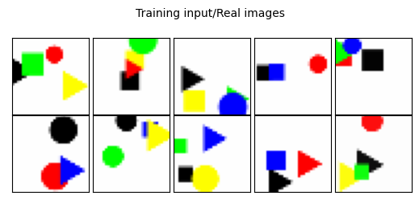
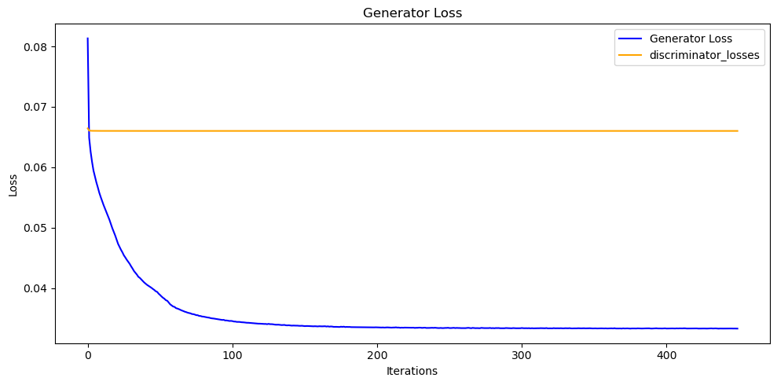

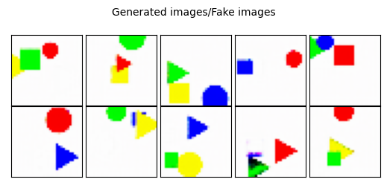
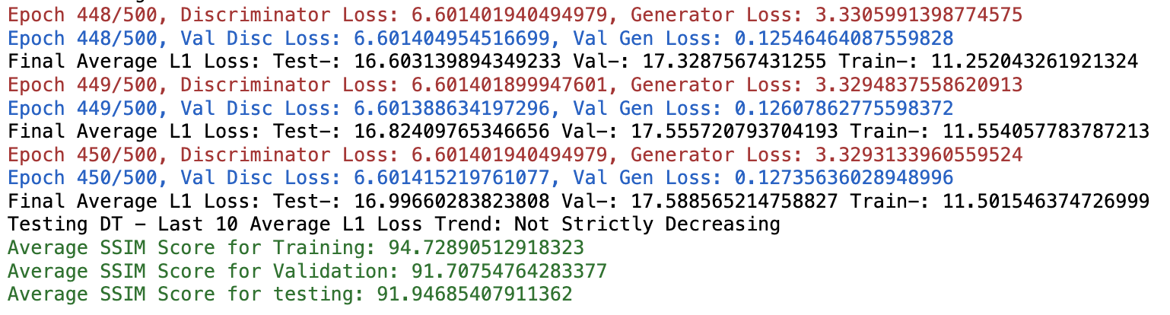
After 450 Epoch

Slide 12
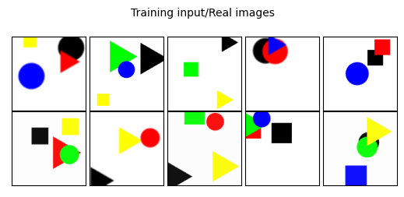
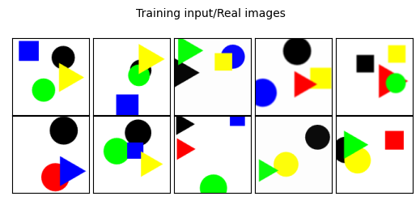
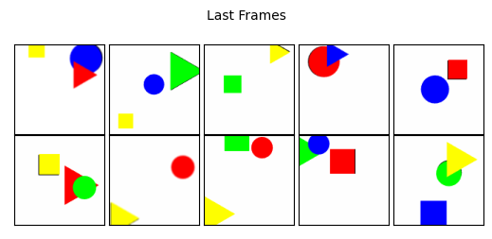
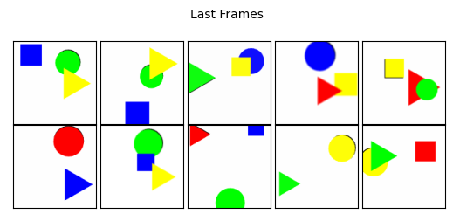
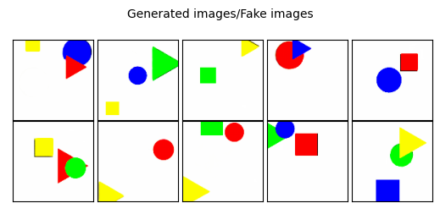

Evaluating Test Dataset
First Frame
Last Frame
Generated Last Frame

Slide 13
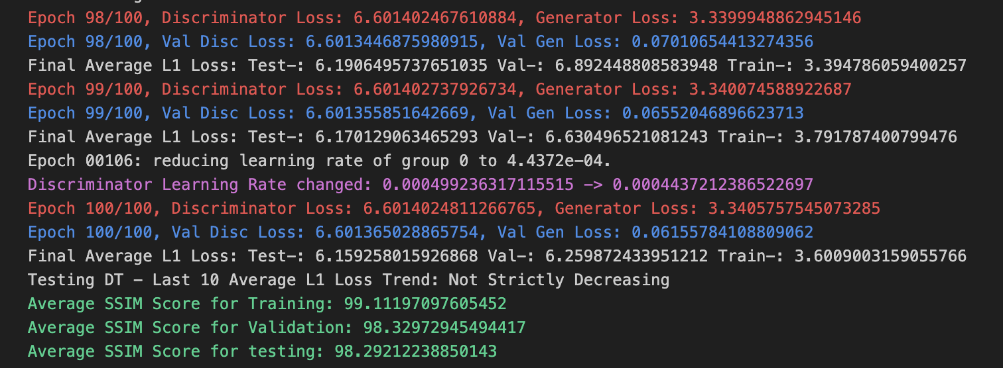
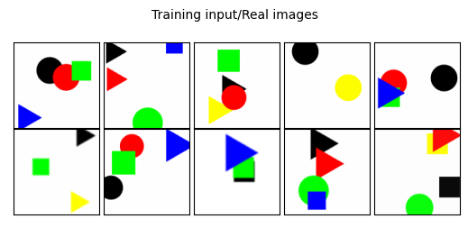
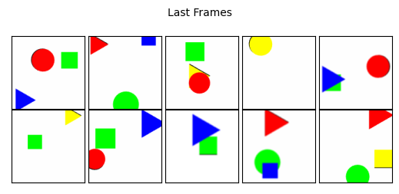
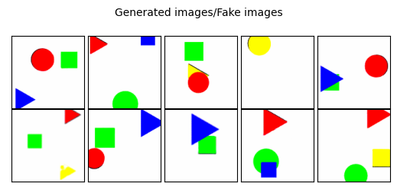
Evaluating Test Dataset

